Slide 1
Optimal Circuit Board Wiring
Jacob Edwards
CSC 437

Slide 2
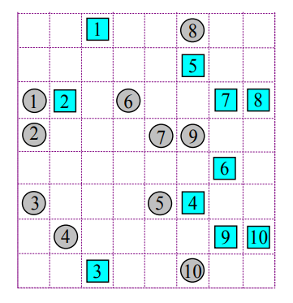
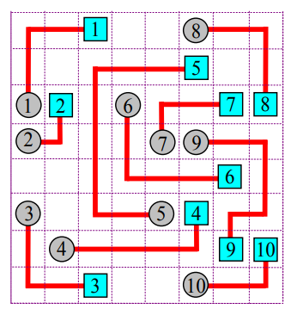
Abstract
VLSI (Very Large Scale Integration) Design requires determining paths between thousands of terminals on a circuit board.
Doing this by hand is virtually impossible
This project implements an algorithm for the efficient routing of multiple terminals on a single layer circuit board.

Slide 3

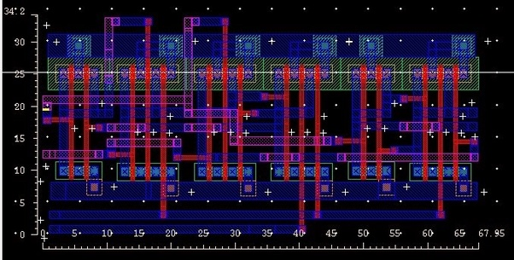
Introduction
In Industry, VLSI design requires wiring thousands or millions of terminals between many layers
Wires can jump between layers, but this is expensive to do 9
If we can maximize the wires on one layer, we don’t have to jump between layers as often

Slide 4
Introduction
Our goal is to minimize the wire length across all terminals
This will allow us to fit more terminals in a given region

Slide 5
System I/O
Set of terminal pairs
Undirected Graph of Region Relationships
Wiring directions for each terminal pair
Wire paths for each terminal pair

Slide 6
System I/O
Set of terminal pairs
Undirected Graph of Region Relationships
Wiring directions for each terminal pair
Wire paths for each terminal pair

Slide 7
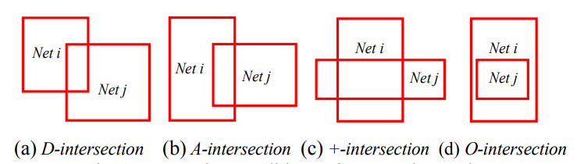
Classifying Region Relationships

Slide 8
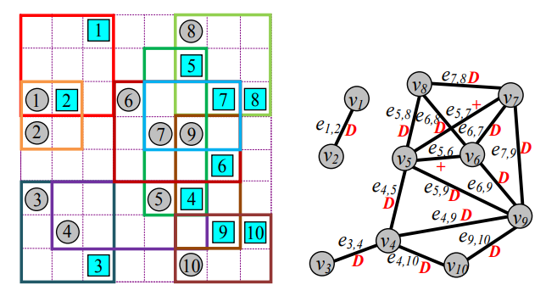
Classifying Region Relationships

Slide 9
System
Set of terminal pairs
Undirected Graph of Region Relationships
Wiring directions for each terminal pair
Wire paths for each terminal pair

Slide 10
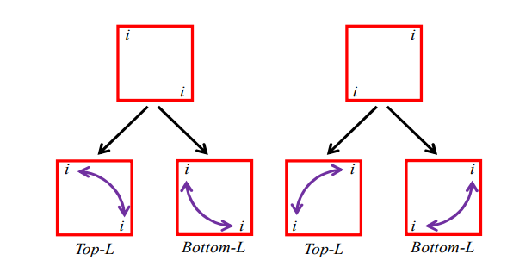
Wire Directions

Slide 11
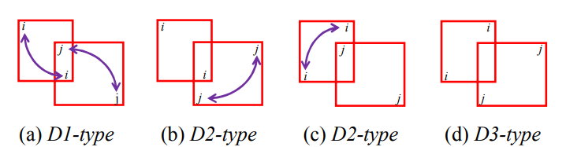
Classifying D-Type Relationships

Slide 12
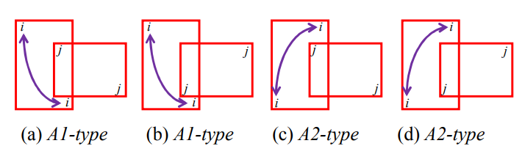
Classifying A-Type Relationships

Slide 13
Classifying O and + Type Relationships
The wiring directions for these types have no restrictions
One of the terminals must be designated as a detour wire
We will deal with this later

Slide 14
Classifying O and + Type Relationships

Slide 15
System
Set of terminal pairs
Undirected Graph of Region Relationships
Wiring directions for each terminal pair
Wire paths for each terminal pair

Slide 16
Order For Classifying All Wire Directions
2) D2 Known Regions
3) D2 Unknown Regions
1) D1 Regions
4) D3 Regions
2) Adjacent Known Regions
3) Adjacent Unknown Regions

Slide 17
System
Set of terminal pairs
Undirected Graph of Region Relationships
Wiring directions for each terminal pair
Wire paths for each terminal pair

Slide 18
Determining Wire Paths
We can determine the exact path a wire should take based on its specified direction (unless it is a detoured wire)
As we construct the path, we check to see if any terminals obstruct our wire’s path
Lee’s Algorithm

Slide 19
Lee’s Algorithm
Used for finding the shortest path between two terminals (vertices in a graph)
We will use it for determining detoured wires’ paths and diffusing obstructed wires

Slide 20

Lee’s Algorithm
Propagate out from starting point
Assign values to each cell
The value is the distance from the cell to the starting point
When you reach the target, follow decreasing values back to start

Slide 21
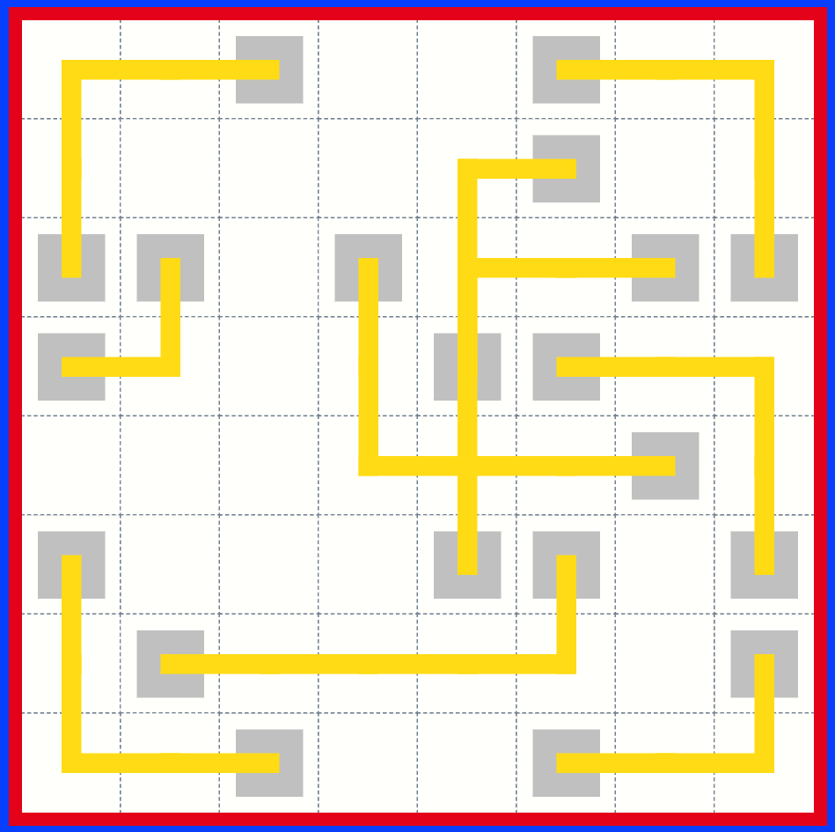
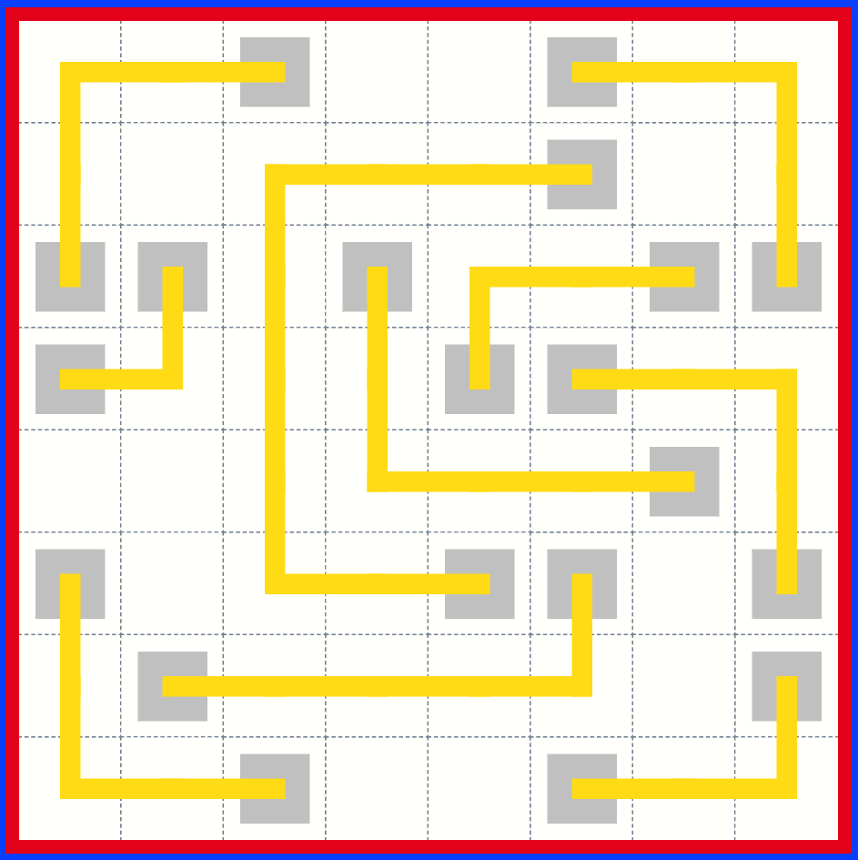
Lee’s Algorithm Effect on Output

Slide 22
Implementation
Written in Javascript
d3.js used for graphics
Webstorm IDE for development and web server (Free for students!)

Slide 23
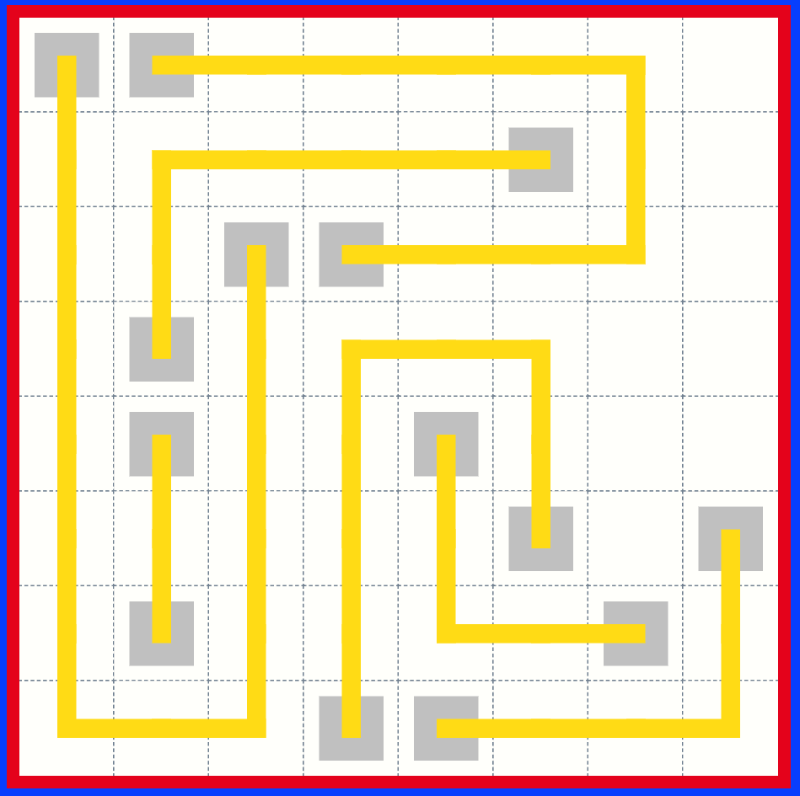
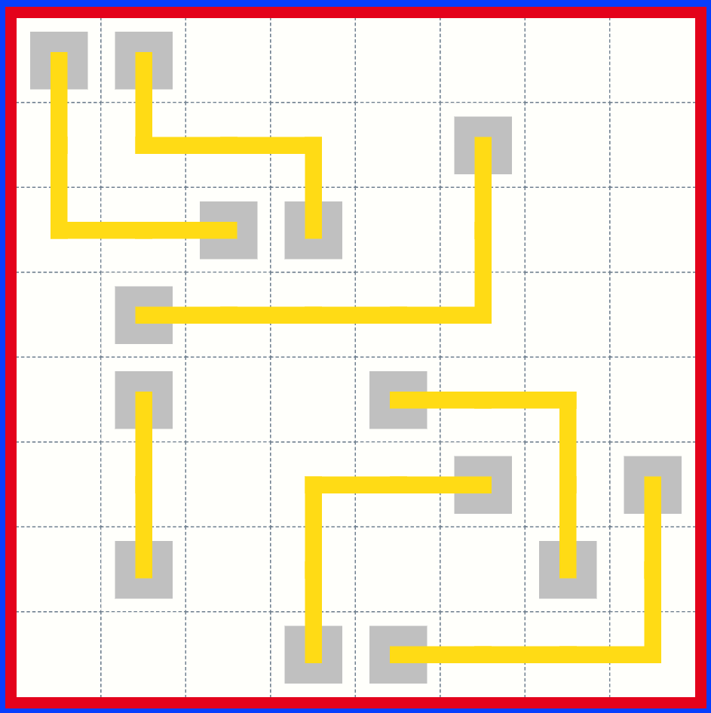
Lee’s Algorithm vs New Algorithm
Average Wire Length: 6
Average Wire Length: 3.1
Free Cells: 7
Free Cells: 26

Slide 24
Conclusion
By looking at all terminals simultaneously, we are better able to decide how they should be connected.
This minimizes average wire length when compared to incremental construction approaches such as Lee’s Algorithm
In the future, this can be extended to multi layer VLSI design
Additionally, we can support orthogonal wiring

Slide 25
Thank You

